Slide 1
NGET ZC Sch16 reinstatement works
HS2
In relation to Mesolithic settlement site - Colne Valley
05 December 2024

Slide 2
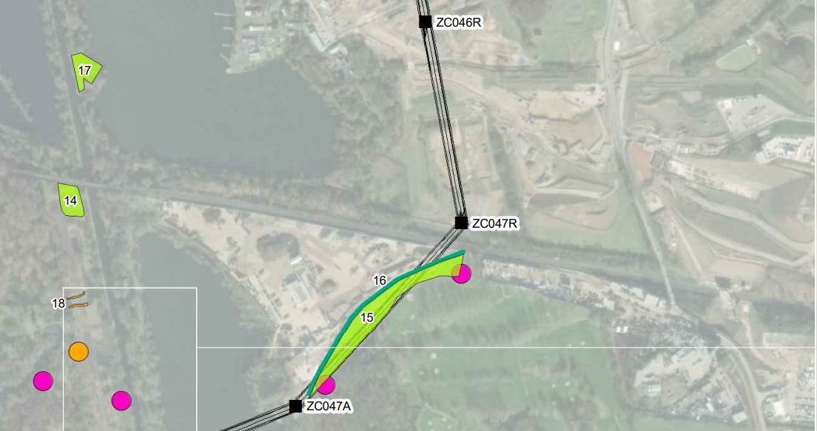
Extract from NGET reinstatement plan with added archaeological site location:
HS2
Mesolithic settlement site
C10049
112m

Slide 3
REQUEST CLARIFICATION OF ARCHAEOLOGICAL IMPACT AND POSSIBLE MODIFICATION OF THE SITE RESTORATION SCHEME
The Greater London Archaeological Advisory Service (GLAAS) provides archaeological advice to boroughs in accordance with the principles set out in the National Planning Policy Framework and GLAAS Charter. In the present context, GLAAS has been providing advice to yourselves and HS2 Ltd on mitigating the archaeological impact of the new railway since the project’s inception and we continue to liaise closely with HS2’s historic environment team and their consultants.
The proposed works are located on ground already evaluated for archaeological interest but Pylon ZC47R lies next to an important Mesolithic settlement site discovered by HS2 and preserved in-situ. There is no mention of this site in the submitted documentation so I request further information as to how it will be avoided and protected in case there is a need to require the scheme’s modification to preserve this site of archaeological interest.
HS2
RESPONSE FROM HS2
The Mesolithic settlement site discovered by HS2 and preserved in-situ is fenced off and is located approximately 112 meters away from ZC47R tower and within HS2 vested land - hence is not part of this consent sought under Sch16 reinstatement application.
The nearest NGET reinstatement works as part of Sch16 reinstatement application (the plots 15 and 16 in the extract above) are located on the other side of the existing railway and have no impact to Mesolithic settlement site.
The work to ensure the preservation of the Mesolithic settlement site was completed by HS2 (Fusion) in 2021 in agreement with and consultation with Historic England (the project design attached to the email for reference).

