Slide 1
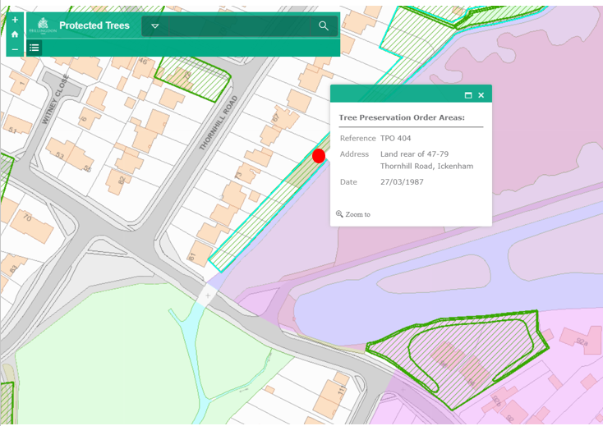
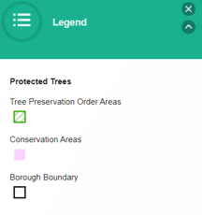
Here is the TPO which protects the tree in question. We only propose to trim the lower branches which over-hang our garden (these are now at floor level). We do not wish to touch any other part of the tree as it gives us privacy (which we value).

Slide 2
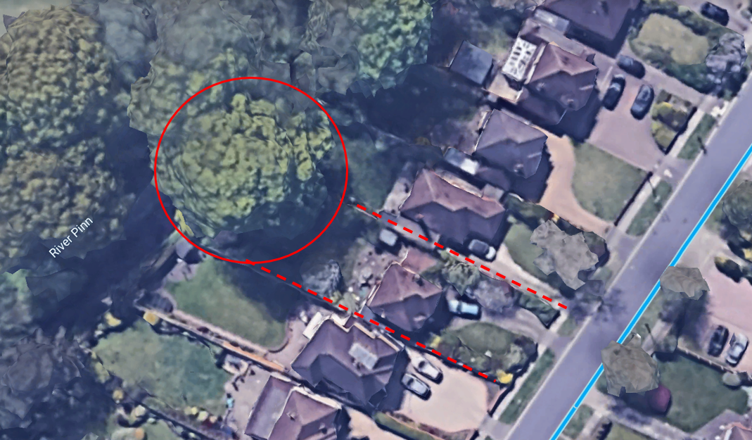
Here is a view of the tree from Google Earth.

Slide 3
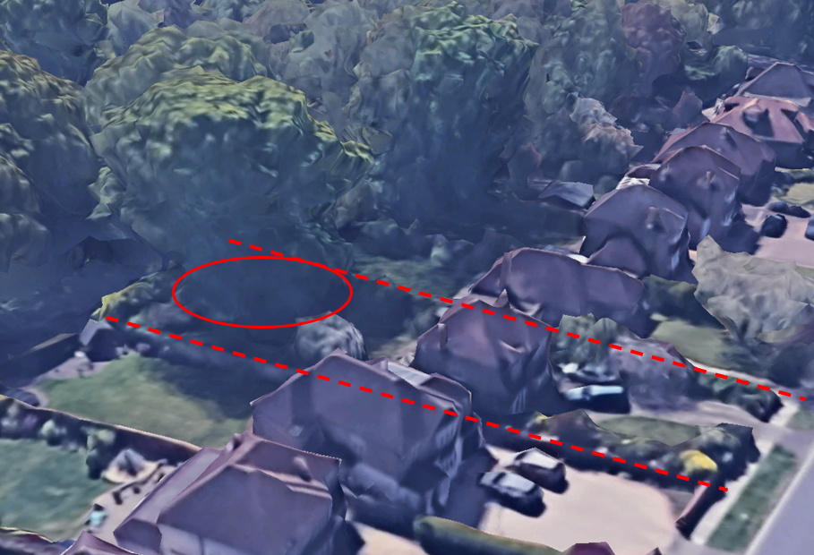
It’s only the lower branches (circled - which now droop to ground/eye level) that I would like to prune please.

Slide 4
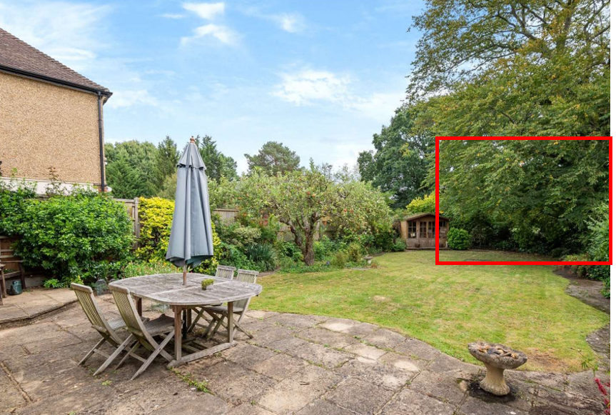
When the tree gets wet, the branches droop even further making it unsafe for our toddler to play in the garden (they are at eye level for him).

