Slide 1
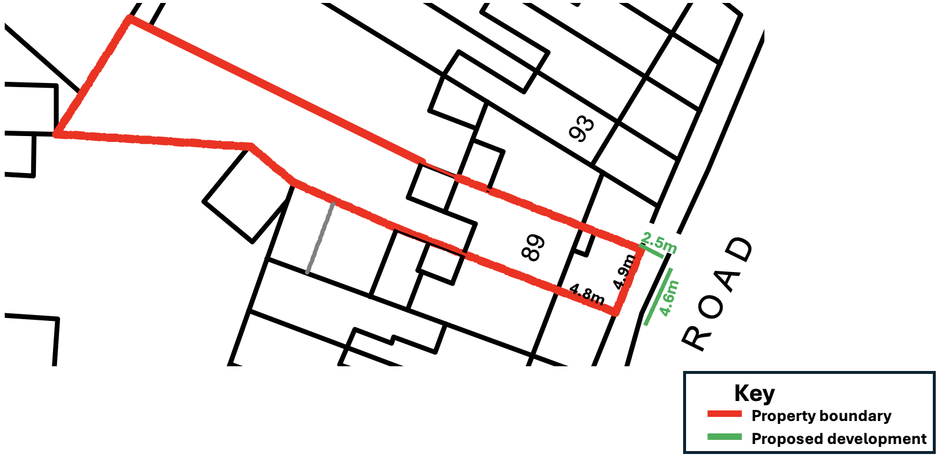
Detailed Location Plan

