Slide 1
Construction Programme – CL 001
Activity Description | 2024 |  |  |  |  |  | 2025 | 2025
 | Nov- Dec | Jan-Feb | Mar-Apr | May-Jun | Jul-Aug | Sep-Oct | Nov-Dec | Jan-Feb | Mar-Apr
BDL Appointed
Clearance of PC Planning Reserve Matters
RIBA Stage 4 Design
Demolition Inc S81
Overall Construction
Site Establishment
Access Road and Parking Bays Inc MUGA Stage 1
Substructures
Superstructures/Envelope/ Roofs
Internal Fit out
Block One –Education Facility
Block Two – 3 Units
Block Three – 3 Units
Block Specific Externals
Main External Works
Inspections & Lock Ups Available
Project Completion
04/12/24
Net Construction Programme 52 Calendar weeks
Critical Path
PC 31/03/25
High Level Programme

Slide 2
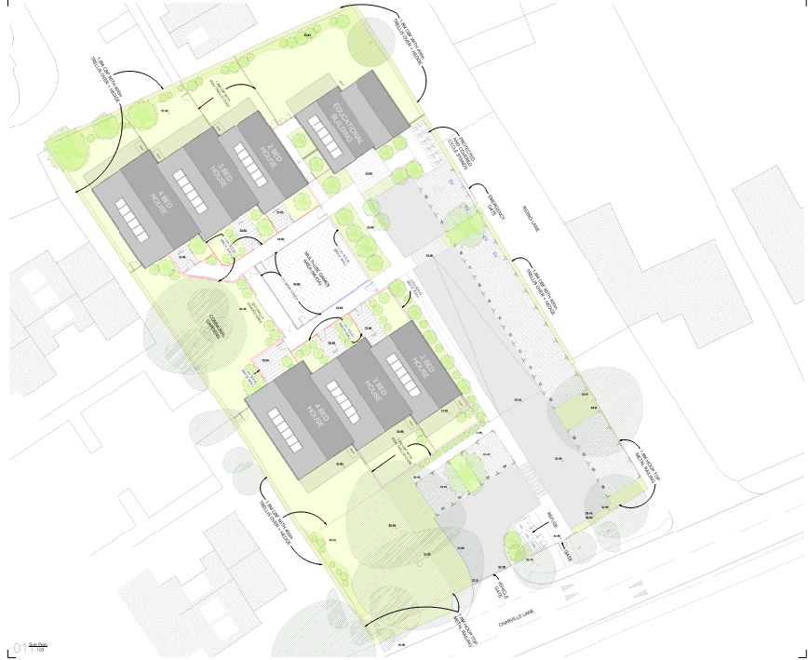

Appendix B – On site Logistics Including Material Storage
Key
Offices
Temporary Oasis Unit for Demo and Site Establishment
Welfare & Office Zone (Safe Zone)
Delivery Zone
Storage Container/zone
Solid 2.4m Hoarding
Close Board Fencing
Delivery Route Main Site
Access Gate
Pedestrian Gates
Main Site Delivery Route
Traffic Marshall
High Level Logistics

Slide 3
 | Site Set up and Roads
Key | Activity | April - June 2024
 |  | 1-2 | 3-4 | 5-6 | 7-8 | 9-10 | 11-12 | 13-14
1 | Temp Site Set Up
2 | Tree Crown Lift
3 | Storm Sewer Connection
4 | Boundary Fencing
5 | Site Access Roads & Parking Bays
6 | Muga Stage 1 (for Storage and Turning)
7 | Full Set Up
6
4
5
8
8. Site parking weeks 1-8
Notes
Demo Completes in week -1
Temp Oasis Unit in Place for Week 1 – 8 whilst parking Bays Construction
Pollarding to trees under approval from LBH
Hoarding to front in place Week 1
Replacement of boundary fencing from Week 2 onwards to remainder of site
MUGA completes in two stages to enable on- site logistics and turning circle
7
1
SW Connection undertaken in two Halves to keep Charville Lane Operational
2
3
Enabling works and Access Roads Stage 1 Sequence: Week 01 – Week 8

Slide 4
Weeks 1 – 8
14.4m x 4.8m which is enough to allow 6 cars to park safely.
During these early stages of work there will be a maximum of 6 operatives working on site. 4 of these will all travel together in one vehicle.

Slide 5
 | Substructures and Superstructures
Key | Activity | July – November 2024
 |  | 11-13 | 14-16 | 17-20 | 21-23 | 24-26 | 27-29 | 30-32
A | Substructures
B | Brickwork & Scaffold
C | Roof construction and Covering
D | Scaffold Strike and Windows
E | Internals Commence
1
Top Out Wk 26
2
Site parking week 9 - 32
Notes
Blocks Numbered 1,2 and 3 as shown – This is also the general sequence of Build
Blocks are served by 1 no loading bay per block which rises with Scaffold
No Access Required around the back of Blocks 1 and 2
Blocks 1 and 2 have a linked scaffold from 1st Lift
MUGA used as part of logistics route
3
Forklift Routes
Substructures and Superstructures Sequence: Week 9 - Week 32

Slide 6
Weeks 9 – 32
14.4m x 4.8m which is enough to accommodate 6 parking spaces and 9.6m x 4.8m which is enough to accommodate a further 4 spaces. 10 spaces in total.
The number of operatives at this stage of the build will be 10 and maximise at 15 as groundworks are being completed and the overlap with bricklayers and scaffolders.

Slide 7
Internal and External Works
Activity | December - March 2024
 | 33-34 | 35-36 | 37-38 | 39-40 | 41-42 | 43-44 | 45-46 | 47-48
Internals
Externals Works
Muga Part 2
Inspections
Decant Site Offices
Project Completion
1
2
Site parking week 33 - 48
3
Notes
Blocks Numbered 1,2 and 3 as shown – This is also the general sequence of Internals
Externals Works released by Scaffold down dates
MUGA Part 2 generated from Block Specific External Works
Inspections on a block by block basis
Internals and External Works Sequence:
Week 33 – Week 48

Slide 8
Weeks 33 - 48
14.4m x 4.8m which is enough to accommodate 6 parking spaces and 9.6m x 4.8m which is enough to accommodate a further 4 spaces. 10 spaces in total.
The number of operatives at this stage of the build will be 10 and maximise at 15 as Internals are being completed and the overlap with groundworkers finishes.

Slide 9
2023
2024
16/10/2023
04/12/2023
02/02/2024
08/04/2024
12/06/2024
02/08/2024
09/02/15
12/06/2024
17/07/2024
Assumed Planning Consent
Execute Contracts
Demolition Complete
Start on Site Construction
Roads Complete Site Established
Substructures Commence
Superstructures Commence
Substructures Complete
Roads
Substructures
Superstructures
2024
2025
25/09/2024
24/10/2024
17/10/2024
14/11/2024
29/01/2025
28/02/2025
07/03/2025
31/03/2025
Internals Start
Watertight All Units
External Works Commence
Superstructures complete
Inspections Commence
All Units Inspected
External Works Complete
All Units Locked Up
Project Completion
Superstructures
Fit Out /Testing and Commissioning/Inspections
Externals Works and MUGA

Slide 10
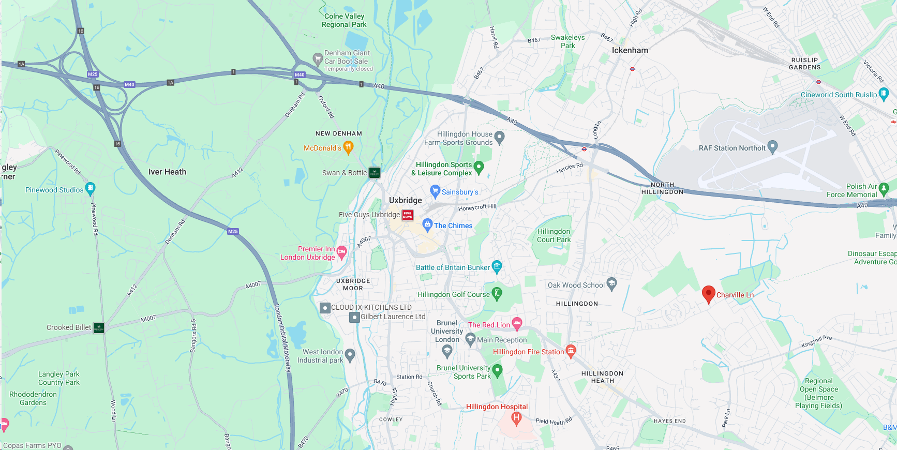

Appendix A – HGV Construction Vehicle Routing
Site Access Via A4020 & Pole Hill Road
Primary Route to Site Via M25 and A40
Secondary Route to Site Via M25 and A40

